Slide 1
Open for Business
Aleksi Kallio, Director, LUMI AI Factory Services
AI Factories: Open for Business – Webinar, May 20, 2025

Slide 2
LUMI-AIF: Exceptional in many ways
The three pillars of LUMI AI Factory
AI-optimised supercomputer LUMI-AI
AI Factory Service Center
Experimental quantum-computing platform LUMI-IQ
Total budget over 612 million euros, marking a serious step up in AI-computing capacity
Backed by a strong consortium of Czechia, Denmark, Estonia, Norway, Poland and Finland (coordinator). Additional countries looking to join as Antennas.
Launched 2nd of April 2025, service provisioning started on current LUMI supercomputer

Slide 3
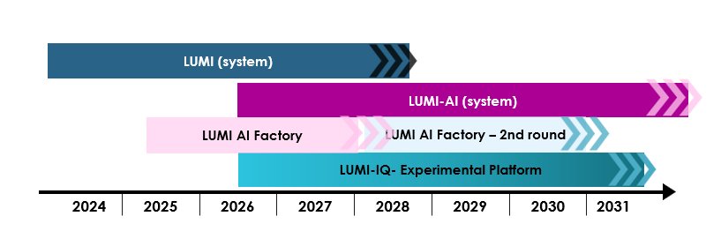
Timeline for the LUMI-AIF
Launch 2nd April 2025

Slide 4
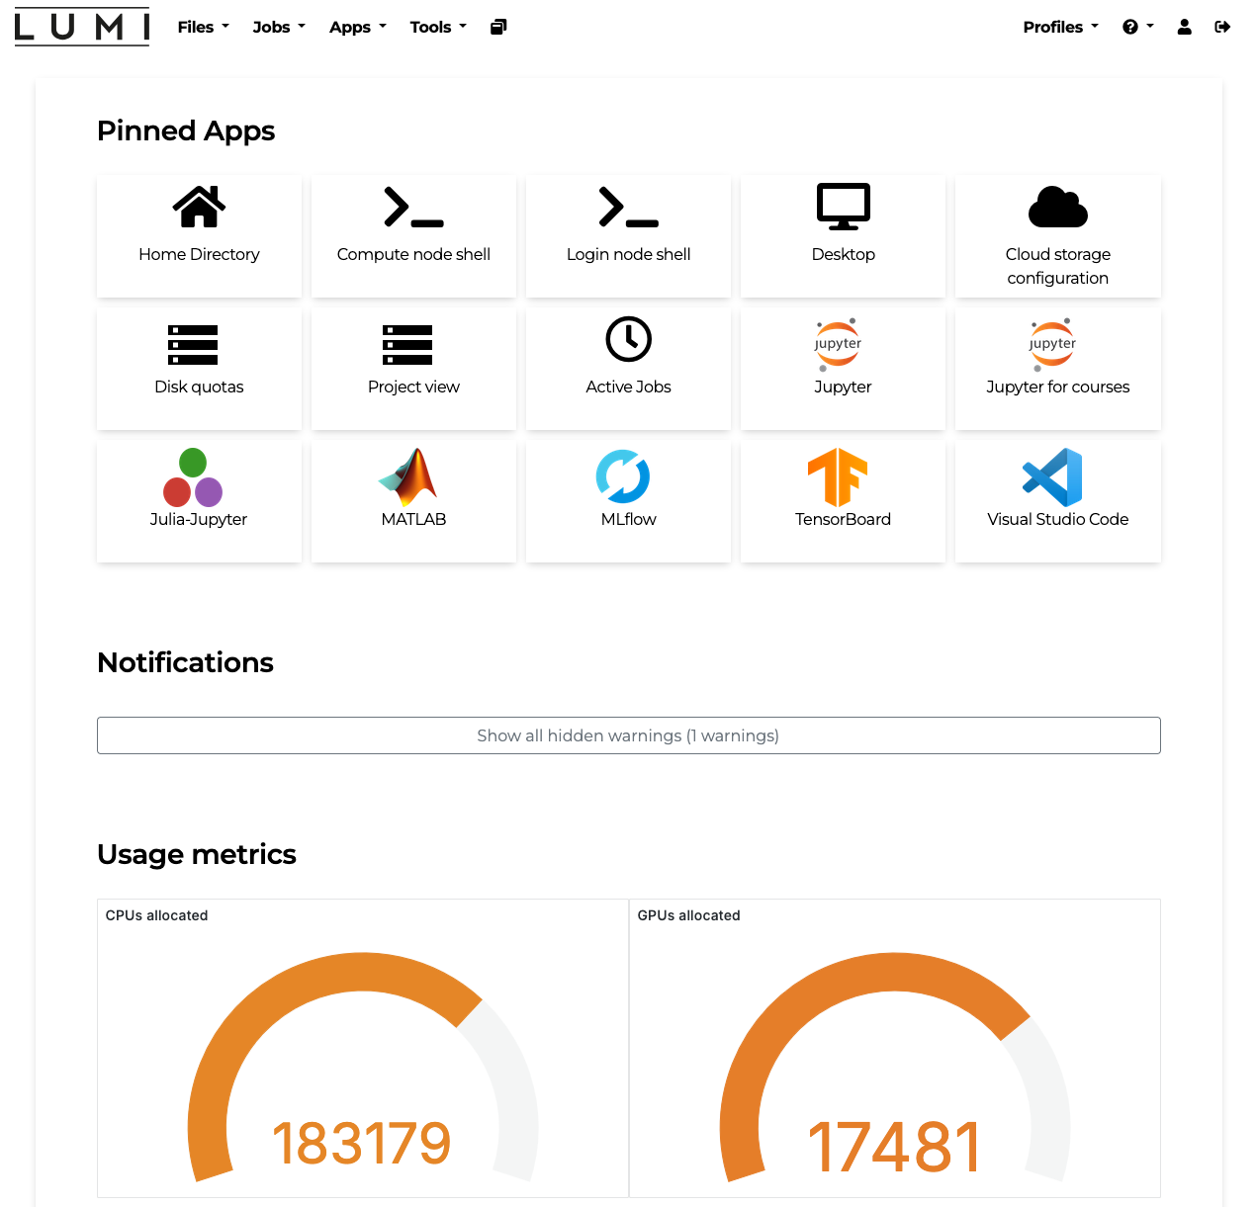
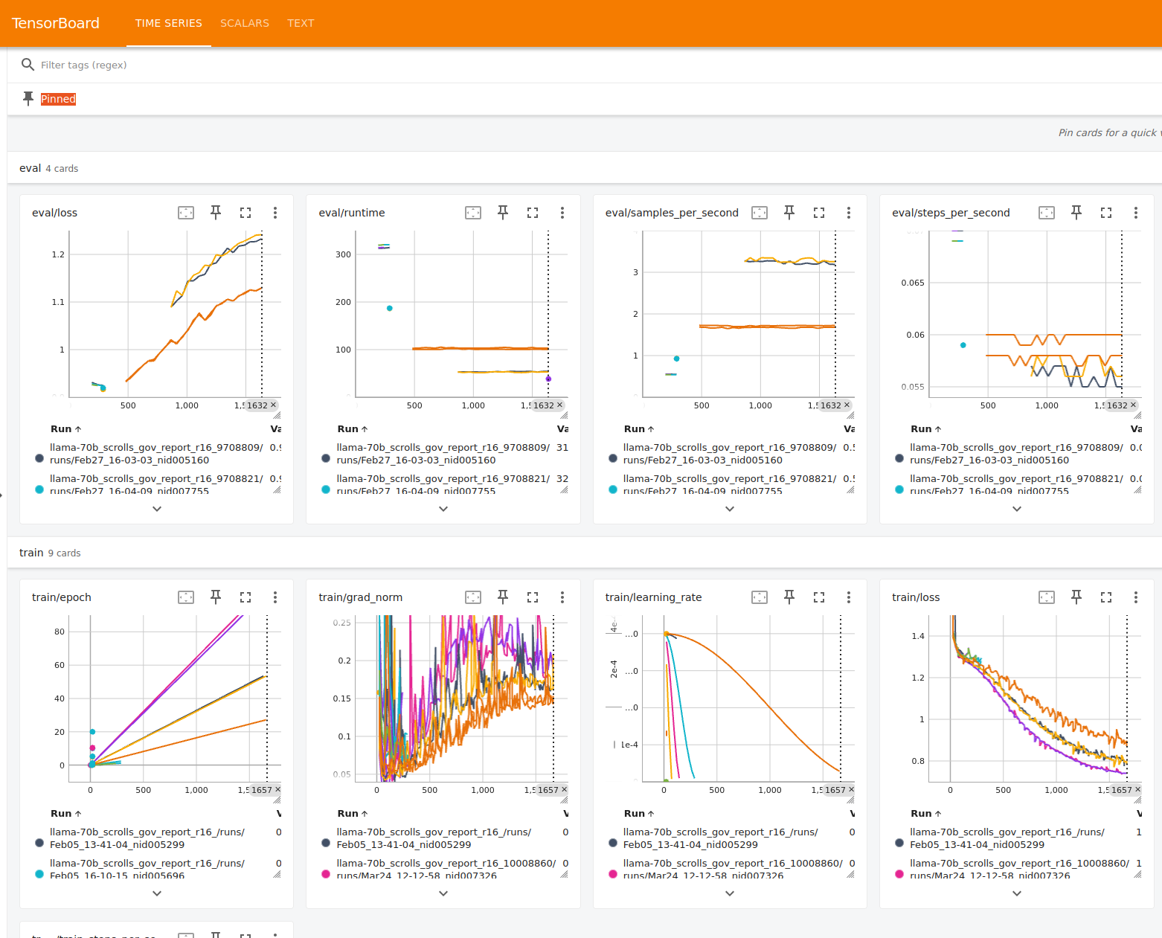
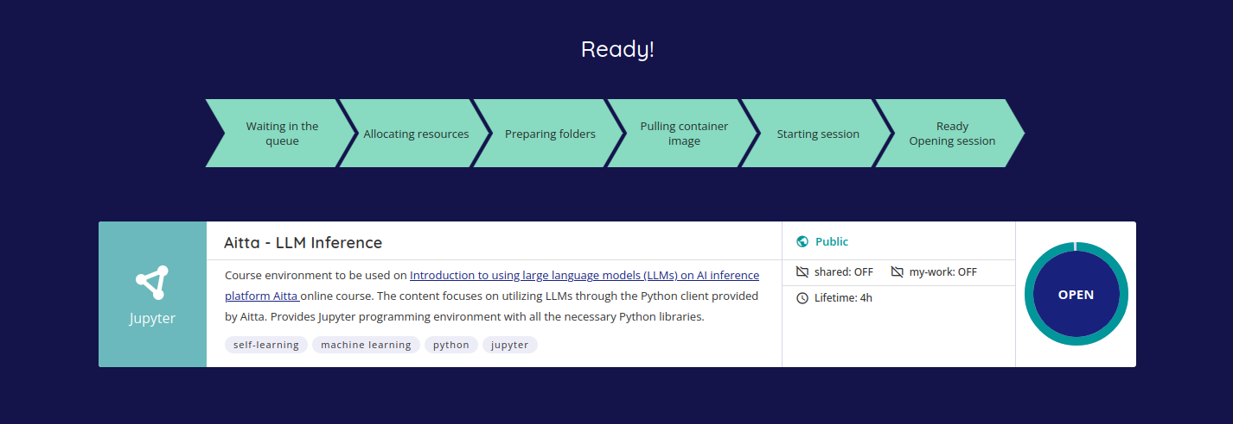
Building on LUMI’s AI environment

Slide 5
Not only a one-stop shop
One-stop shop: a comprehensive service portfolio provided by a large consortium, with a track record of effective collaboration in LUMI consortium
Big push for service productisation to carve out well-packaged service products => make offering easy to approach to user communities outside of HPC realm and ensure scalability for all types of services
Beyond one-stop-shop: leverage service products and make LUMI-AIF a first-class citizen in dozens of AI networks and communities: incubators, accelerators, EDIH’s, TEF’s, challenges, campuses, hacklabs, sectoral communities…

Slide 6
Customer journey across communities
A hackathon on satellite data is organised on a regional AI campus for student participants.
One of the teams wants to continue working on their ideas and joins a startup incubator.
Company joins an accelerator program and launches the complete product to the market.
The company develops the idea into an MVP.
AI Factory support: provide computing & data platform and capacity, as well as support in AI methods and evaluating technical feasibility of the plans.
AI Factory support: sourcing large data collections and bringing them to the platform for validating the MVP.
AI Factory support:
consulting on technical and compliance questions to reduce time to market.
AI Factory support:
offer computing & data platform.

Slide 7
Services to unlock research, development and innovation potential
Comprehensive services for compute, data and talent, with extra effort to specific topics where European communities stand out from the crowd
Services for talent
On-line and on-site training, consultation for AI readiness, starter packs, AI adoption interventions, co-working spaces as interface to early innovators
Building on existing collaborations for modular training programs to make LUMI-AIF content widely adopted among AI communities
Services for data
Cloud-like data environment, data space and repository integration, support team for data access, negotiation, wrangling
Allowing to tap into major European assets with solutions for sensitive and confidential data
Datasets-as-a-Service: exclusive high-impact datasets hosted and maintained
Streaming data support to tackle challenges in 6G, edge, autonomous vehicles, smart cities etc.

Slide 8
Services for compute, at scale
Globally leading AI computing platform, shared and dedicated capacity, confidential computing, MLOps environment, cloud integration and API-based access, fast lanes for ambitious startups
AI inference service to speed up transition to next wave of frontier AI models
Accelerated adoption with a self-service environment, thorough documentation and AI Assistant at disposal
Gathering speed for the quantum race: the integrated European LUMI-IQ system will make LUMI-AIF the most advanced combined HPC+AI+QC platform in the world

Slide 9
LUMI-AI system architecture
User access
partition
GPU partition
Multi-core partition
LUMI-IQ
Batch job
Interactive
Instance- based and API access
/home, /project
Flash-based /scratch
Application-optimized
LUMI-O
External (and LUMI) data spaces

Slide 10
Summary – Building AI sovereignty in Europe
Enabling frontier AI models with an exceptionally large AI-supercomputer, supported by a wide consortium and deep tech support
Comprehensive services woven into AI networks, user communities and industrial ecosystems
Additional effort to hand picked services that strengthen competitive edges within the consortium countries and in Europe as whole

Slide 11
Contact us through lumi-supercomputer.eu

