Slide 1
EuroHPC Summit 2024
Dr. Gustav Kalbe Acting Director - DG CONNECT, EUROPEAN COMMISSION

Slide 2
EuroHPC Mission
Develop, deploy, extend and maintain in the Union a world leading federated, secure and hyper-connected supercomputing, quantum computing, service and data infrastructure ecosystem; support the production of innovative and competitive supercomputing systems based on a supply chain that will ensure components, technologies and knowledge limiting the risk of disruptions and the development of a wide range of applications optimised for these systems; and, widen the use of this supercomputing infrastructure to a large number of public and private users, and support the development of key skills for European science and industry.

Slide 3
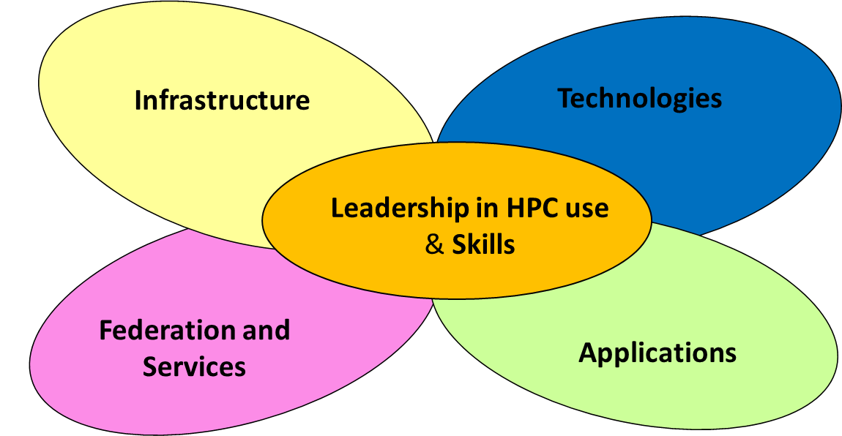
EuroHPC Objectives
A Federated supercomputing infrastructure
Exascale and post exascale supercomputers
Mid-range supercomputers
Industrial-grade supercomputers
Quantum Computers
The 5 Pillars of activity
Technologies & Applications for the HPC ecosystem
R&D on new computing technologies and architectures and their integration in supercomputing systems
Advanced industrial, scientific and public sector applications
Leadership in use and Skills
Wide use primarily for civilian applications – incl. for EU strategic initiatives (e.g. Destination Earth, personalised health, crisis management, etc.)
HPC Skills, Education, Training

Slide 4
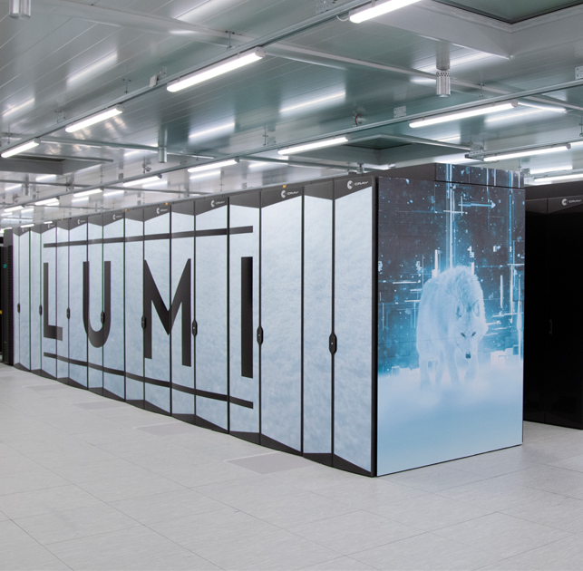
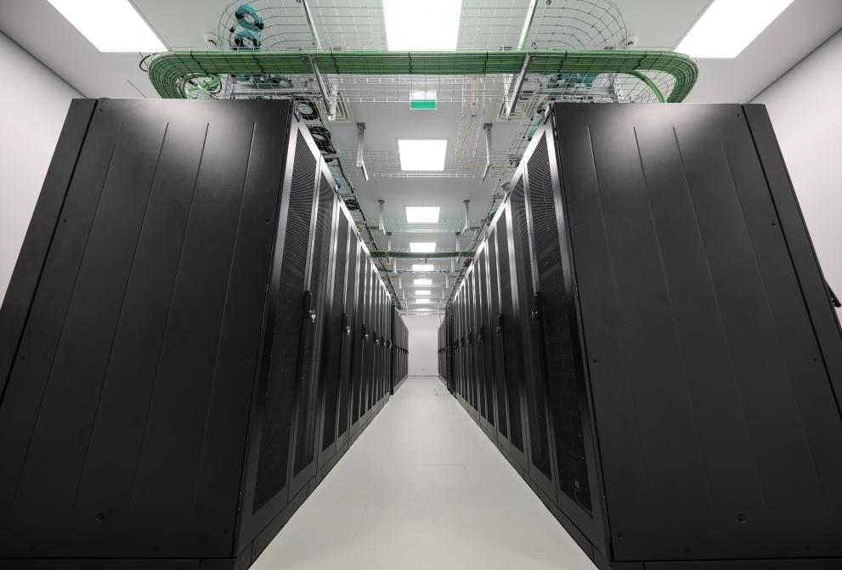
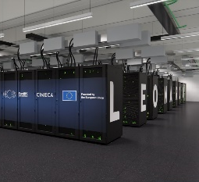
HPC Infrastructure 2018 - 2023
EXASCALE
Lumi (FI)
PRE-EXASCALE
World-class computing capacities for scientific, industrial or public users available across Europe
Since 2018, the EU has multiplied by 14 fold its total computing power
EuroHPC systems represent 53% of the total supercomputing capacity in the EU
more than 1.2 exaflops of theoretical computing power
Access granted to ~ 300 projects, from 33 countries
Arrhenius (SE)
PETASCALE
MID-RANGE
CASPIr (IE)
EHPCPL (PL)
Jupiter (DE)
Meluxina (LU)
Karolina (CZ)
JULES VERNE (FR)
Levente (HU)
Vega (SI)
Leonardo (IT)
Discoverer (BG)
Deucalion (PT)
MareNostrum 5 (ES)
Daedalus (GR)

Slide 5
Coming up – Federation / Hyperconnectivity
Lumi (FI)
EXASCALE
A hyper-connected, federated, and secure HPC and quantum computing service and data infrastructure ecosystem
Federation of EuroHPC resources (2024)
Computing services
Interactive Computing, Cloud access, Virtual Machines, Containers
Data services
Data repositories, Data mover / transport services
User and Resource management
Authentication, Authorization, Identification (AAI)
Hyperconnectivity (2025)
Arrhenius (SE)
PRE-EXASCALE
PETASCALE
CASPIr (IE)
MID-RANGE
Q-computer
Q-simulator
EHPCPL (PL)
Meluxina (LU)
Jupiter (DE)
Karolina (CZ)
JULES VERNE (FR)
Vega (SI)
Levente (HU)
Discoverer (BG)
Leonardo (IT)
Deucalion (PT)
MareNostrum 5 (ES)
Daedalus (GR)
Daedalus (GR)

Slide 6
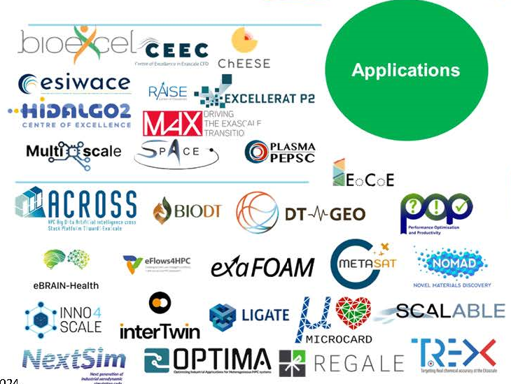
Applications and use
15 HPC Centres of Excellence
National HPC Centres of Competence
EPICURE –HPC application support service, Application Support Teams (ASTs)
European-wide HPC application support service
Education/Skills: EUMaster4HPC

Slide 7
Technological Sovereignty
$624 Billion of Global Semiconductor market revenue expected in 2024 - EU 20% of market but 10% of sales
Chips Act - create large innovation capacity and a resilient and dynamic semiconductor ecosystem
Generative AI (GenAI) is driving a strong demand for accelerators supporting both training and inference of AI workloads
NO EU processor technology in the top 500 world supercomputers

Slide 8
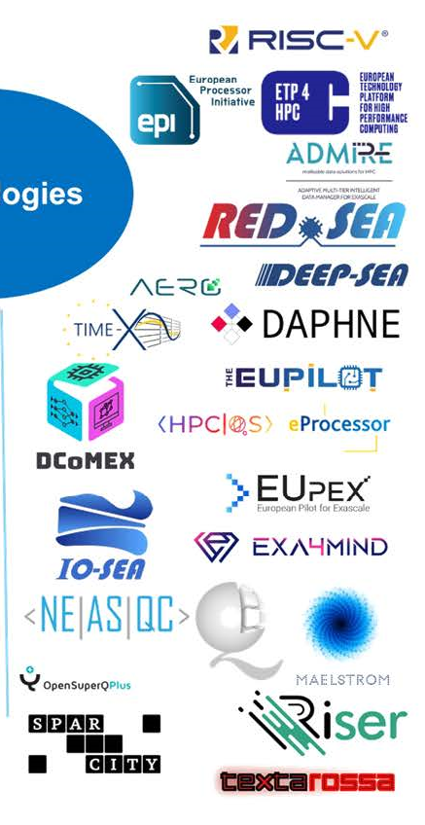
Technological Sovereignty
European Processor Initiative (EPI):
EUPilot, EUPEX pilots integrating EU technology
Rhea (SiPearl) – powering JUPITER
EPAC - first European RISC-V acceleration
RISC-V – FPA (DARE)
High-end general purpose processors
AI accelerators

Slide 9
Quantum Computing
Why? | Supercomputer | Quantum computer
'travelling salesman’: plan a route between 30 cities | 1+ million years | a few minutes
drug discovery: processing molecules | 100s or 1000s at a time, multiple attempts needed | billions simultaneously
QT Flagship achievements (2018-2021)
Trapped-ion qubits
World record entanglement 24 qubits
50 qubits prototype
2 online quantum computers​
Reached commercial stage
Superconducting qubits
25 qubit chip processors with world-leading capabilities
quantum error-correction breakthrough​
Reached commercial stage
Save time, energy and money
Target for the Digital Decade
By 2025, first EU computer with quantum acceleration
By 2030, Europe at the cutting edge of quantum capabilities (operational stand-alone quantum computer, quantum supremacy)

Slide 10
EuroHPC – Quantum Computing infrastructure (2024+)
Lumi (FI)
EXASCALE
Integration of QC with HPC and development of hybrid HPC-QC applications and workflows
Transfer European research to technology and infrastructure
Free access for R&D&I
Coordinated development of a European quantum computing SW stack
European Quantum Excellence Centres in quantum applications, for science and industry
Arrhenius (SE)
PRE-EXASCALE
CASPIr (IE)
PETASCALE
MID-RANGE
Q-computer
EHPCPL (PL)
Q-simulator
Meluxina (LU)
Jupiter (DE)
Karolina (CZ)
JULES VERNE (FR)
Vega (SI)
Levente (HU)
Discoverer (BG)
Deucalion (PT)
Leonardo (IT)
MareNostrum 5 (ES)
Daedalus (GR)

Slide 11
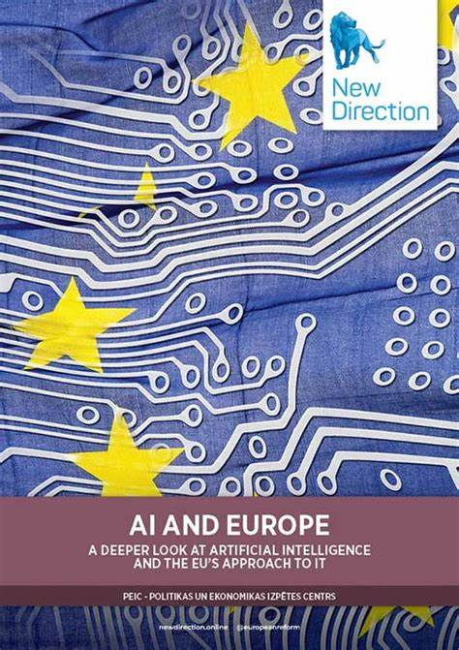
Communication on boosting startups and innovation in trustworthy artificial intelligence
Two Main Interlinked Objectives:
AI Factories
Making available HPC computing capacity to facilitate the development of GenAI models
GenAI4EU
Stimulating the development in strategic sectors of novel and innovative applications based on GenAI models and facilitating their uptake.
11

Slide 12
AI Factories
Talent & Competences
Data centre
Data Spaces
Data Spaces
One Stop-Shop
The EU’s AI-oriented super-computers
Access & AI-HPC services
AI Ecosystem*
supercomputer-friendly programming facilities
*AI Ecosystem:
Testing and Experimentation Facilities, AIonDemand Platform, AINetworks of Excellence, AI-Data-Robotics PPP
12

Slide 13
EuroHPC is a real European success story!
World-class HPC infrastructure
Excellence in applications and use
Contributing to EU’s technological sovereignty
Quantum Computing Infrastructure under deployment
AI factories next

Slide 14
Thank you for your attention

